Slide 1
PROJECT SERIES
DATEWITHDATA

Slide 2
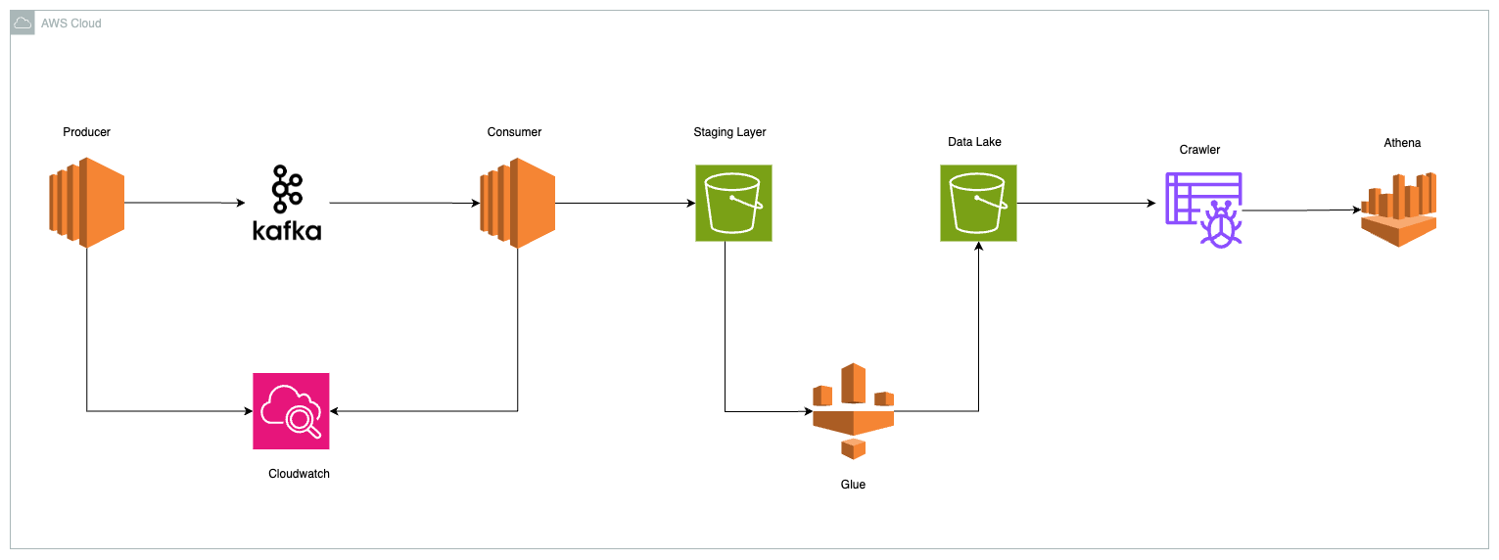
Project Architecture

Slide 3
Apache Kafka
Super-efficient messenger that helps different parts of a big system communicate
Kafka is really good at handling lots of messages really quickly and making sure they get where they need to go.
Kafka helps businesses manage and process huge amounts of data in real-time, making sure everything runs smoothly and efficiently.

Slide 4
Project Setup
Kafka Setup
AWS Cloud Environment Setup

